Slide 1
CDL Protocol

Slide 2
Basic Data Exchange Services
Read Pool
PGB
ADT
SPB

Slide 3
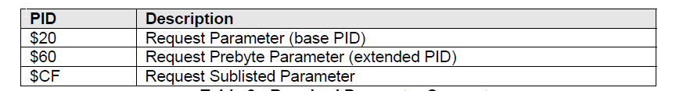
Read pool - Parameter Read
It works on every request- response.
one-time transmission of specific parameter information
Data can be requested at :specific request rate, start up, Navigation to a specific screen
IDs: 20/60/CF

Slide 4
Data Capture –Read pool
Request: SVC ECM $20 $80 CS
Response: ECM SVC $80 $06 device_id CS
Request: SVC ECM $20 $40 CS
Response: ECM SVC $40 $A4 $06 CS
Request: SVC ECM $60 $F4 $21 CS
Response: ECM SVC $F4 $21 $32 $00 CS
Request: SVC ECM $CF $00D0 $0011 CS
Response: ECM SVC $D0 $0011 $data CS

Slide 5
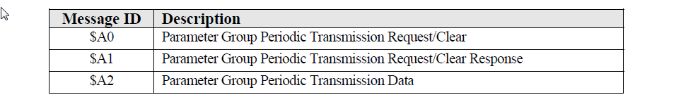
PGB - Parameter Group Broadcast
Requested at start up / every key cycle one-time.
periodic transfer of data
IDs: A0/ A1/A2

Slide 6
Data Capture – PGB
Terminate:
Request: CLI SVR $A0 $01 $7F CS
Response: SVR CLI $A1 $01 $7F CS
Broadcast:
Request: CLI SVR $A0 byte_cnt ref_ID_tag desired_trans_rate desired_PID_list CS
Response: SVR CLI $A1 byte_cnt ref_ID_tag actual_trans_rate actual_ordered_PID_list CS (Sever accepts)
Response: SVR CLI $A1 $00 CS (Server denies)
Active Broadcast:
Broadcast: SVR CLI $A2 byte_count ref_ID_tag data1, data2, … datan CS

Slide 7
Data Capture – PGB
Example:
REQUEST: 35 24 A0 06 10 03 E8 D1 08 90 9D
RESPONSE: 24 35 A1 06 10 03 E8 D1 08 90 9C
DATA: 24 35 A2 03 10 00 5D 95

Slide 8
SPB – Standard Parameter Broadcast
periodic data transfer without periodic data request messages
IDs: BC – request, BD- response
Termination:
ReqID RspID $BC $01 $FF CS
RspID ReqID $BD $01 $FF CS
Parameter Broadcast Request
Request: REQID RSPID $BC n $00 Broadcast_rate PID1 PID2 . . . PIDn CS
Response: REQID RSPID $BD n Message# Broadcast_rate PID1 PID2 . . . PIDn CS
Data: RSPID REQID PID1 DATA1 PID2 DATA2 . . . PIDN DATAN CS

Slide 9
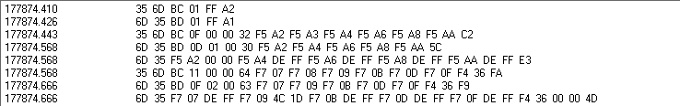
Data Capture example - SPB
Request: REQID RSPID $BC $07 $00 $0003 $40 $15 $F002 CS
Response: RSPID REQID $BD $05 $01 $0002 $40 $15 CS
XMIT: RSPID REQID $40 $100E $15 $10 CS

Slide 10
ADT
Transfer data for a parameter only when the data value changes.
More efficient than periodic messaging.
Periodic ‘heartbeat’ message from source to requesting ECM.
Does not support multi-byte PIDs
4 byte data PIDs is max supported
20 – 3 byte PID & 10- 2 byte PID
ID: F836, F837, FC2F, F612

Slide 11
Data Capture – ADT
Termination
Request: ReqID DatID $F836 $02 $F0 $FF CS
Response: DatID ReqID $F837 $02 $F0 $FF CS
Create the Asynchronous Connection
Request: ReqID DatID $F836 $0A $20 $01 $00D1 $0027 $10 $0F $F023 CS
Response: DatID ReqID $F837 $04 $20 $01 $10 $0F CS
Report Initial Data for New Parameters
Request: DatID ReqID $FC2F $00 $01 $002A CS
Response: ReqID DatID $F612 $00 $01 CS
Request: DatID ReqID $FC2F $01 $0F $0000 CS
Response: ReqID DatID $F612 $01 $0F CS

Slide 12
Data Capture- ADT
Asynchronous Interlock Heartbeat
Request: DatID ReqID $FC2F $02 $FF $01 $02 CS
Response: ReqID DatID $F612 $02 $FF CS
1 second passes without any data report updates
Request: DatID ReqID $FC2F $03 $FF $02 $02 CS
Response: ReqID DatID $F612 $03 $FF CS
Message Transfer on data change:
Request: DatID ReqID $FC2F $04 $01 $002B CS
Response: ReqID DatID $F612 $04 $01 CS
1 second passes without any data report updates
Request: DatID ReqID $FC2F $05 $FF $03 $03 CS
Response: ReqID DatID $F612 $05 $FF CS

